Slide 1
Free Inquiry Reflection #3
Jessica McDougall
February 5, 2021

Slide 2
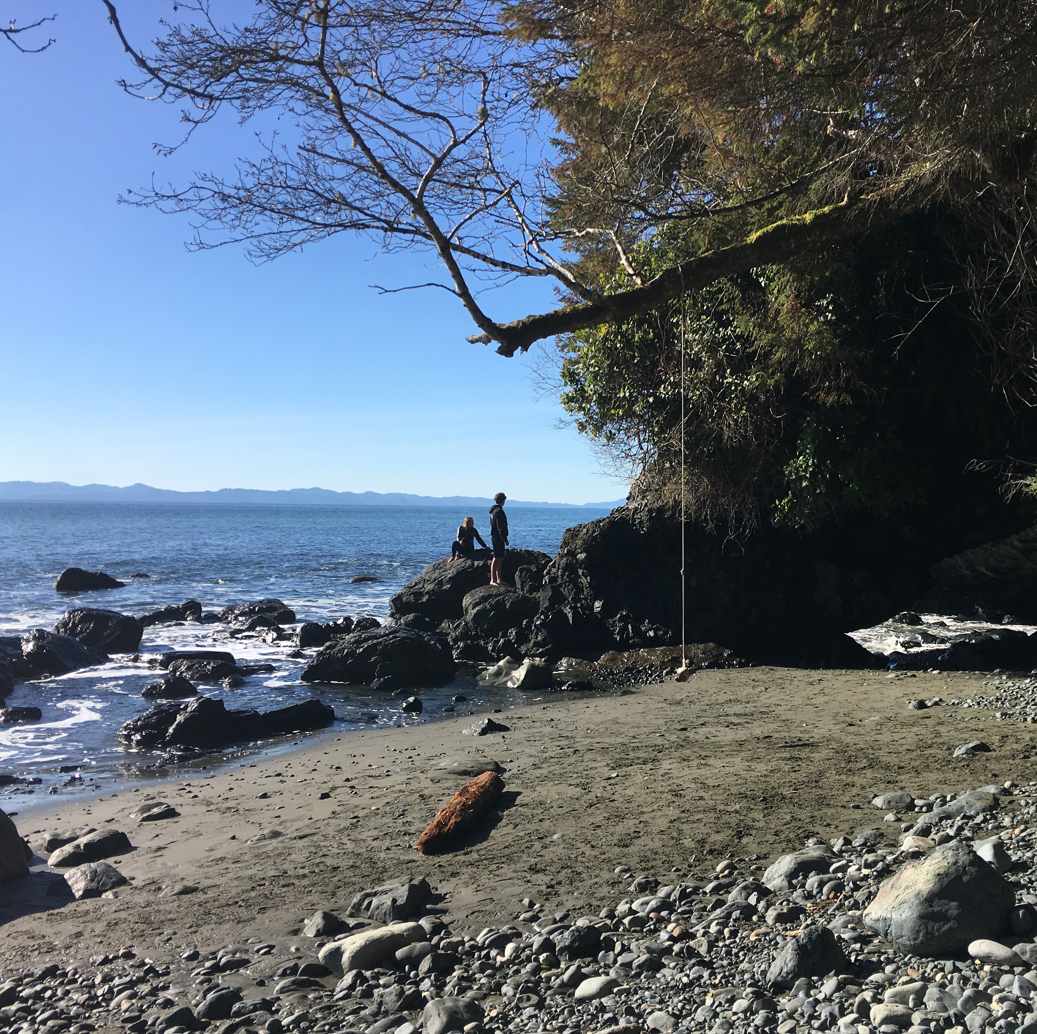
This Week’s Inquiry Reflection
Based on our previous lectures, I have decided to incorporate our learnings with PowerPoint to discuss my inquiry reflection for this week
As aforementioned in my previous reflection posts regarding my inquiry, my topic is primarily based on exploring nature and its benefits on mental and physical health in individuals

Slide 3
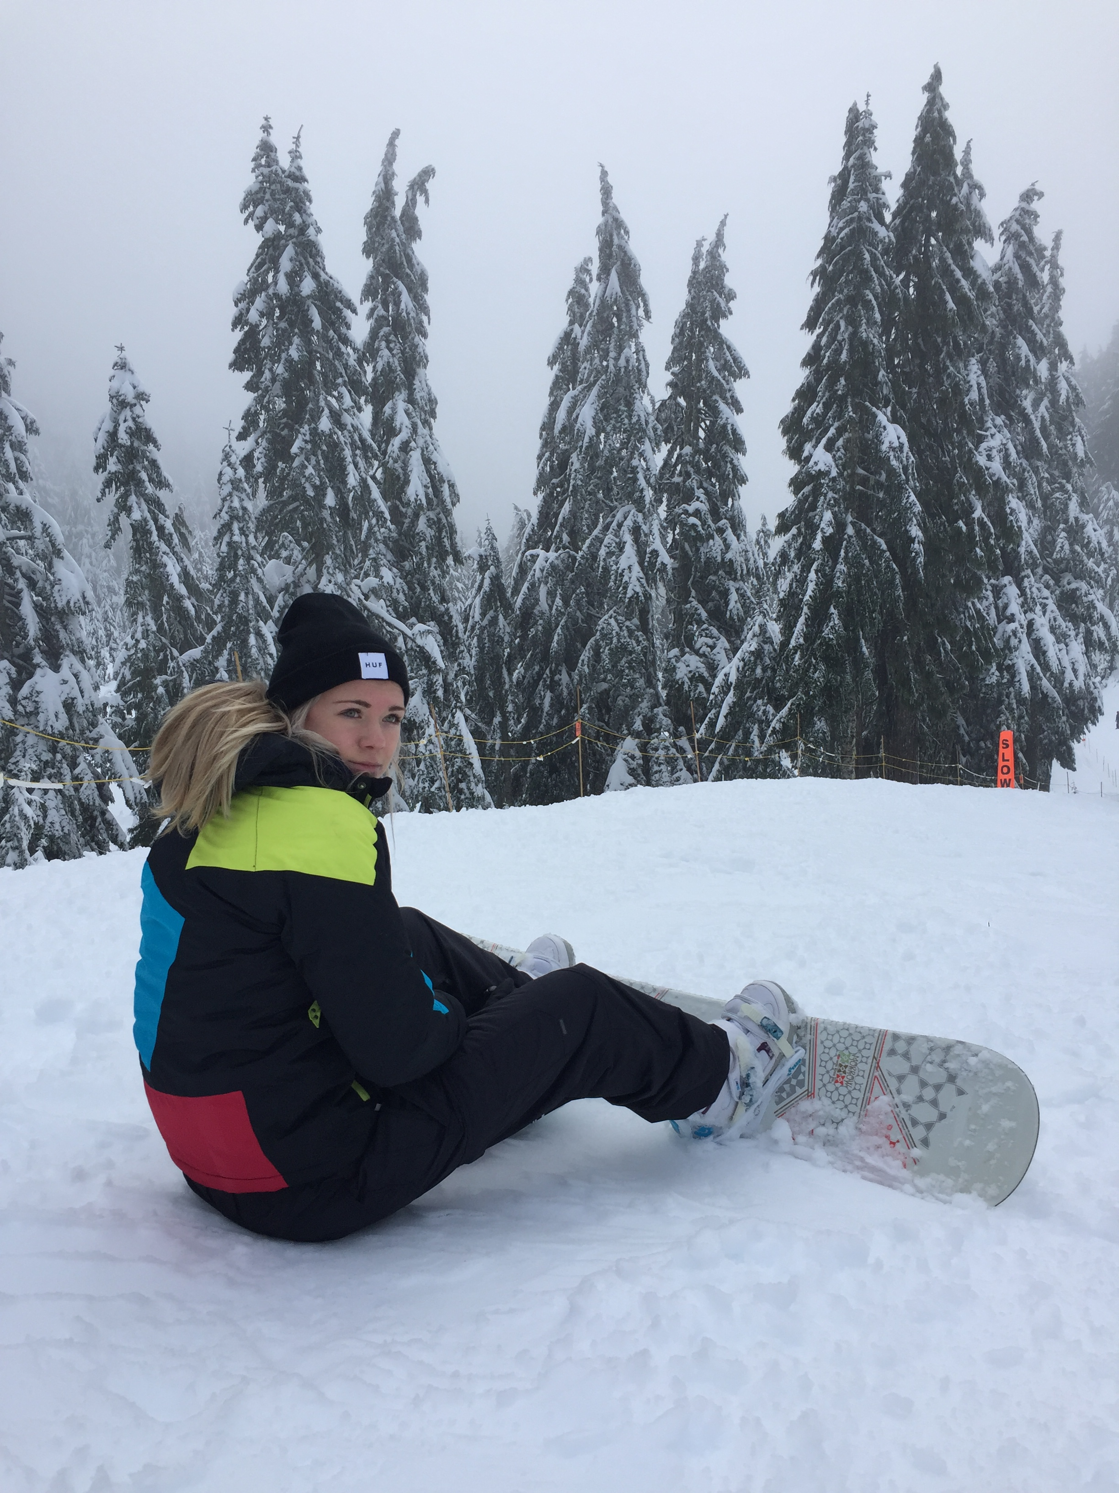
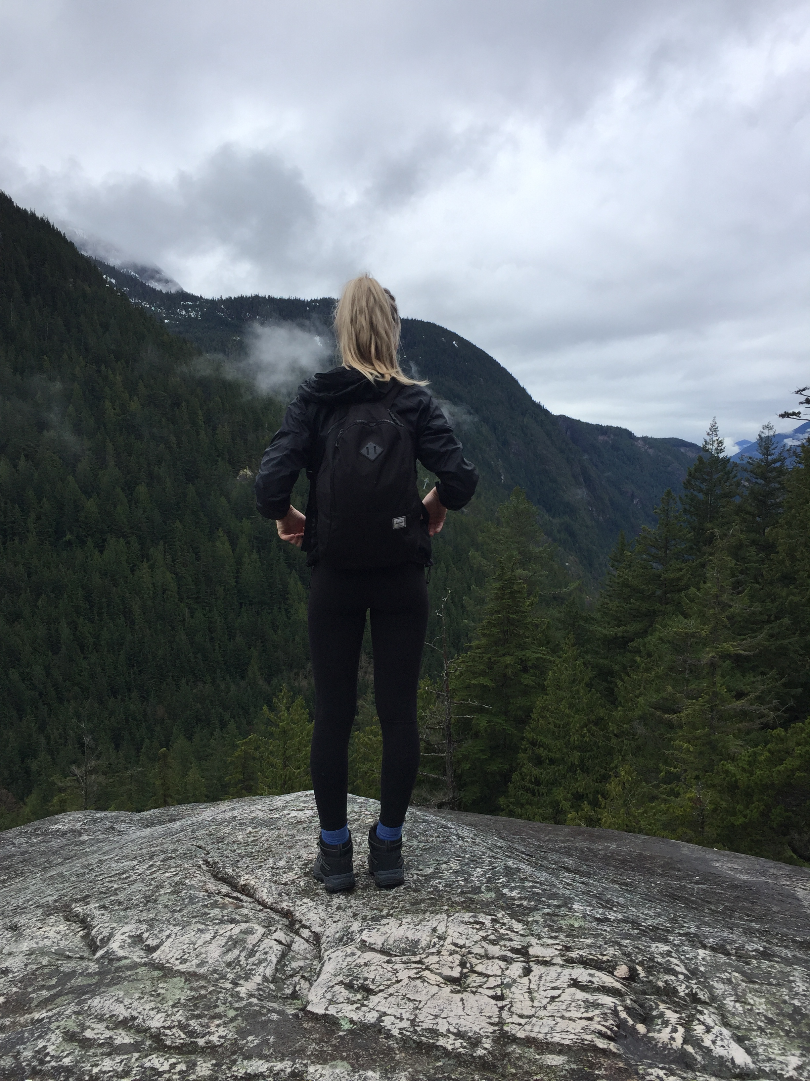
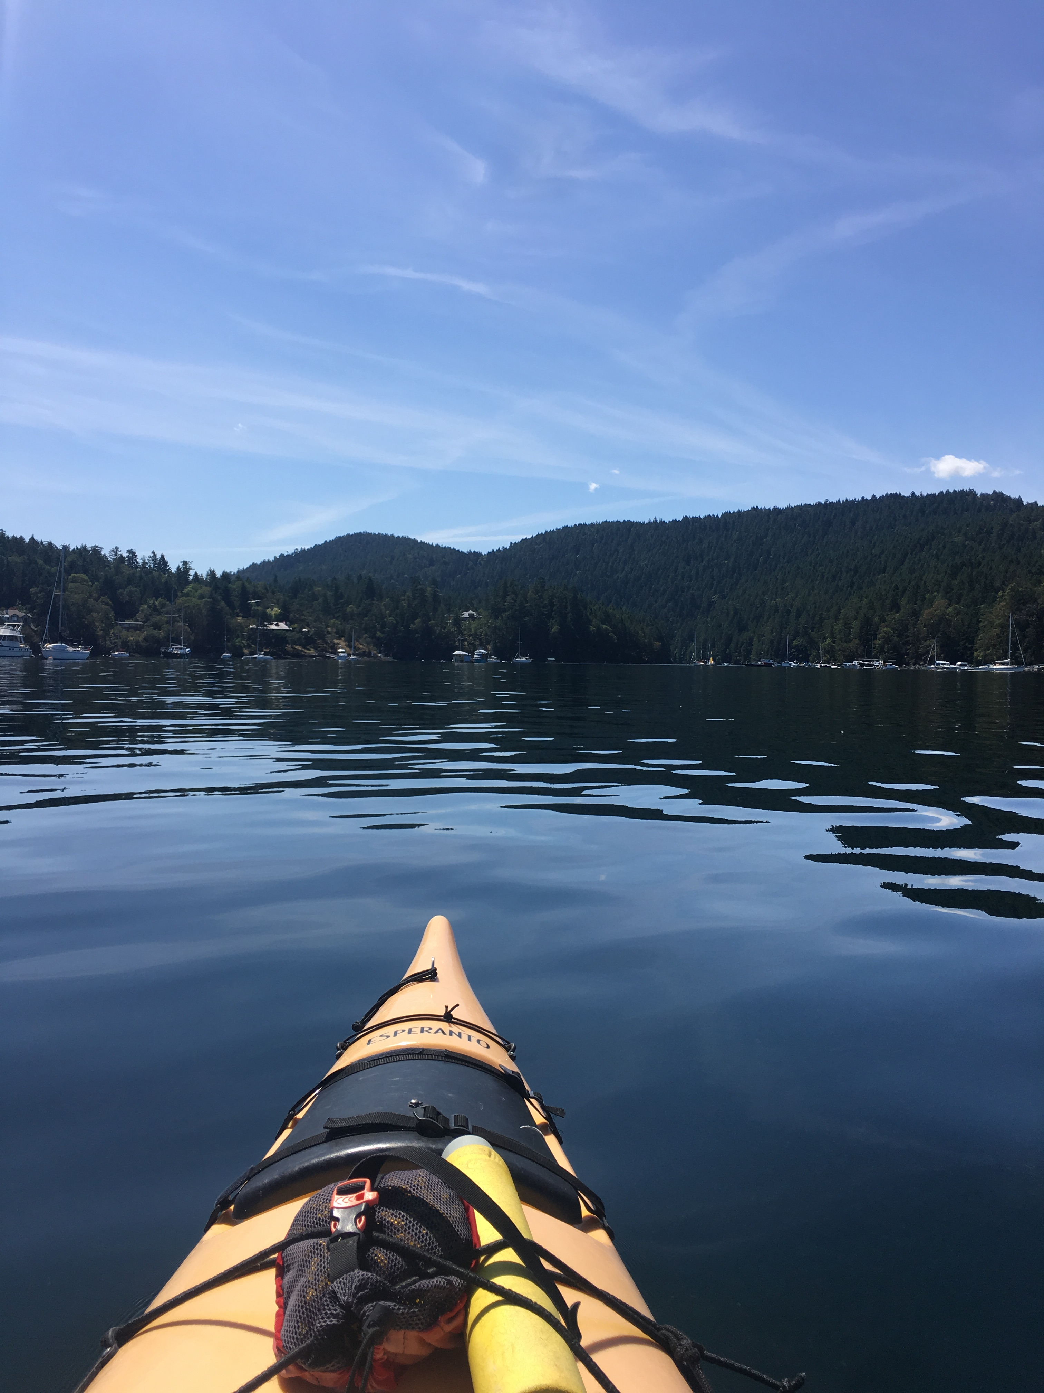
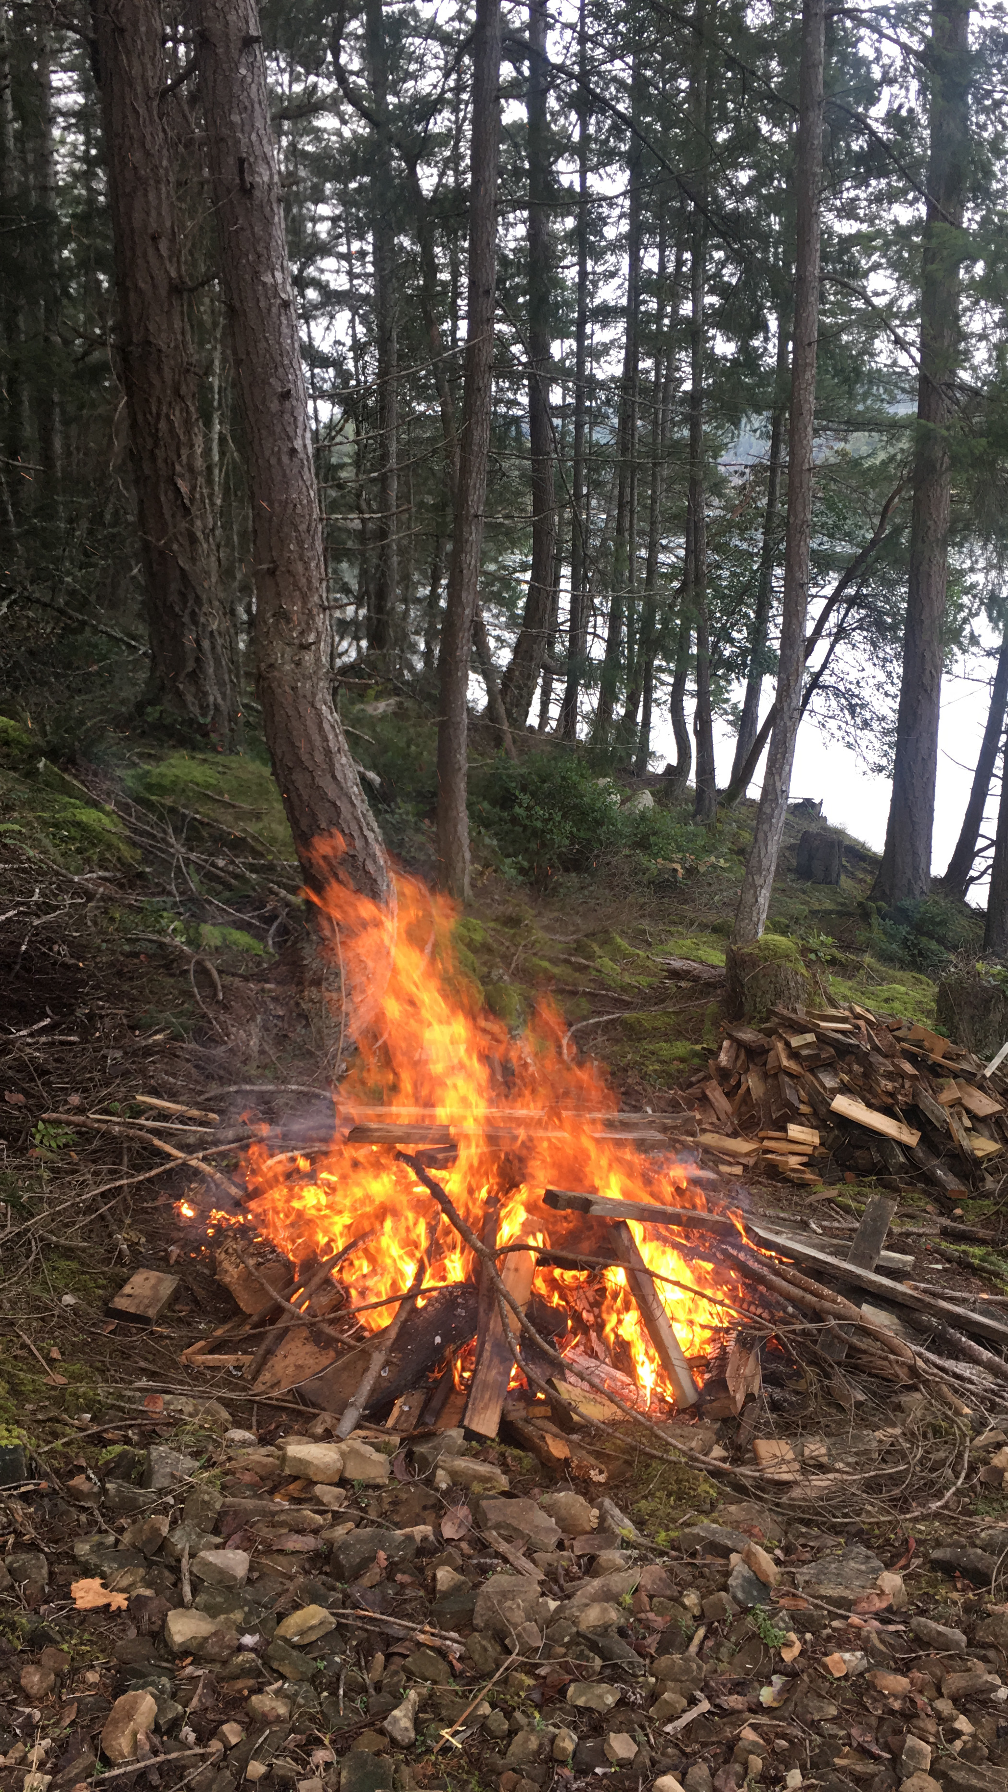
Activities Associated with the Outdoors
Exploring the outdoors can be more than simply going on a walk in your local neighborhood to get fresh air. Exploring the outdoors has a wide variety of activities to engage in to fully experience the benefits of nature to positively impact an individuals physical and mental health
Below are a few photographs of diverse outdoor activities that I have taken during my adventures

Slide 4
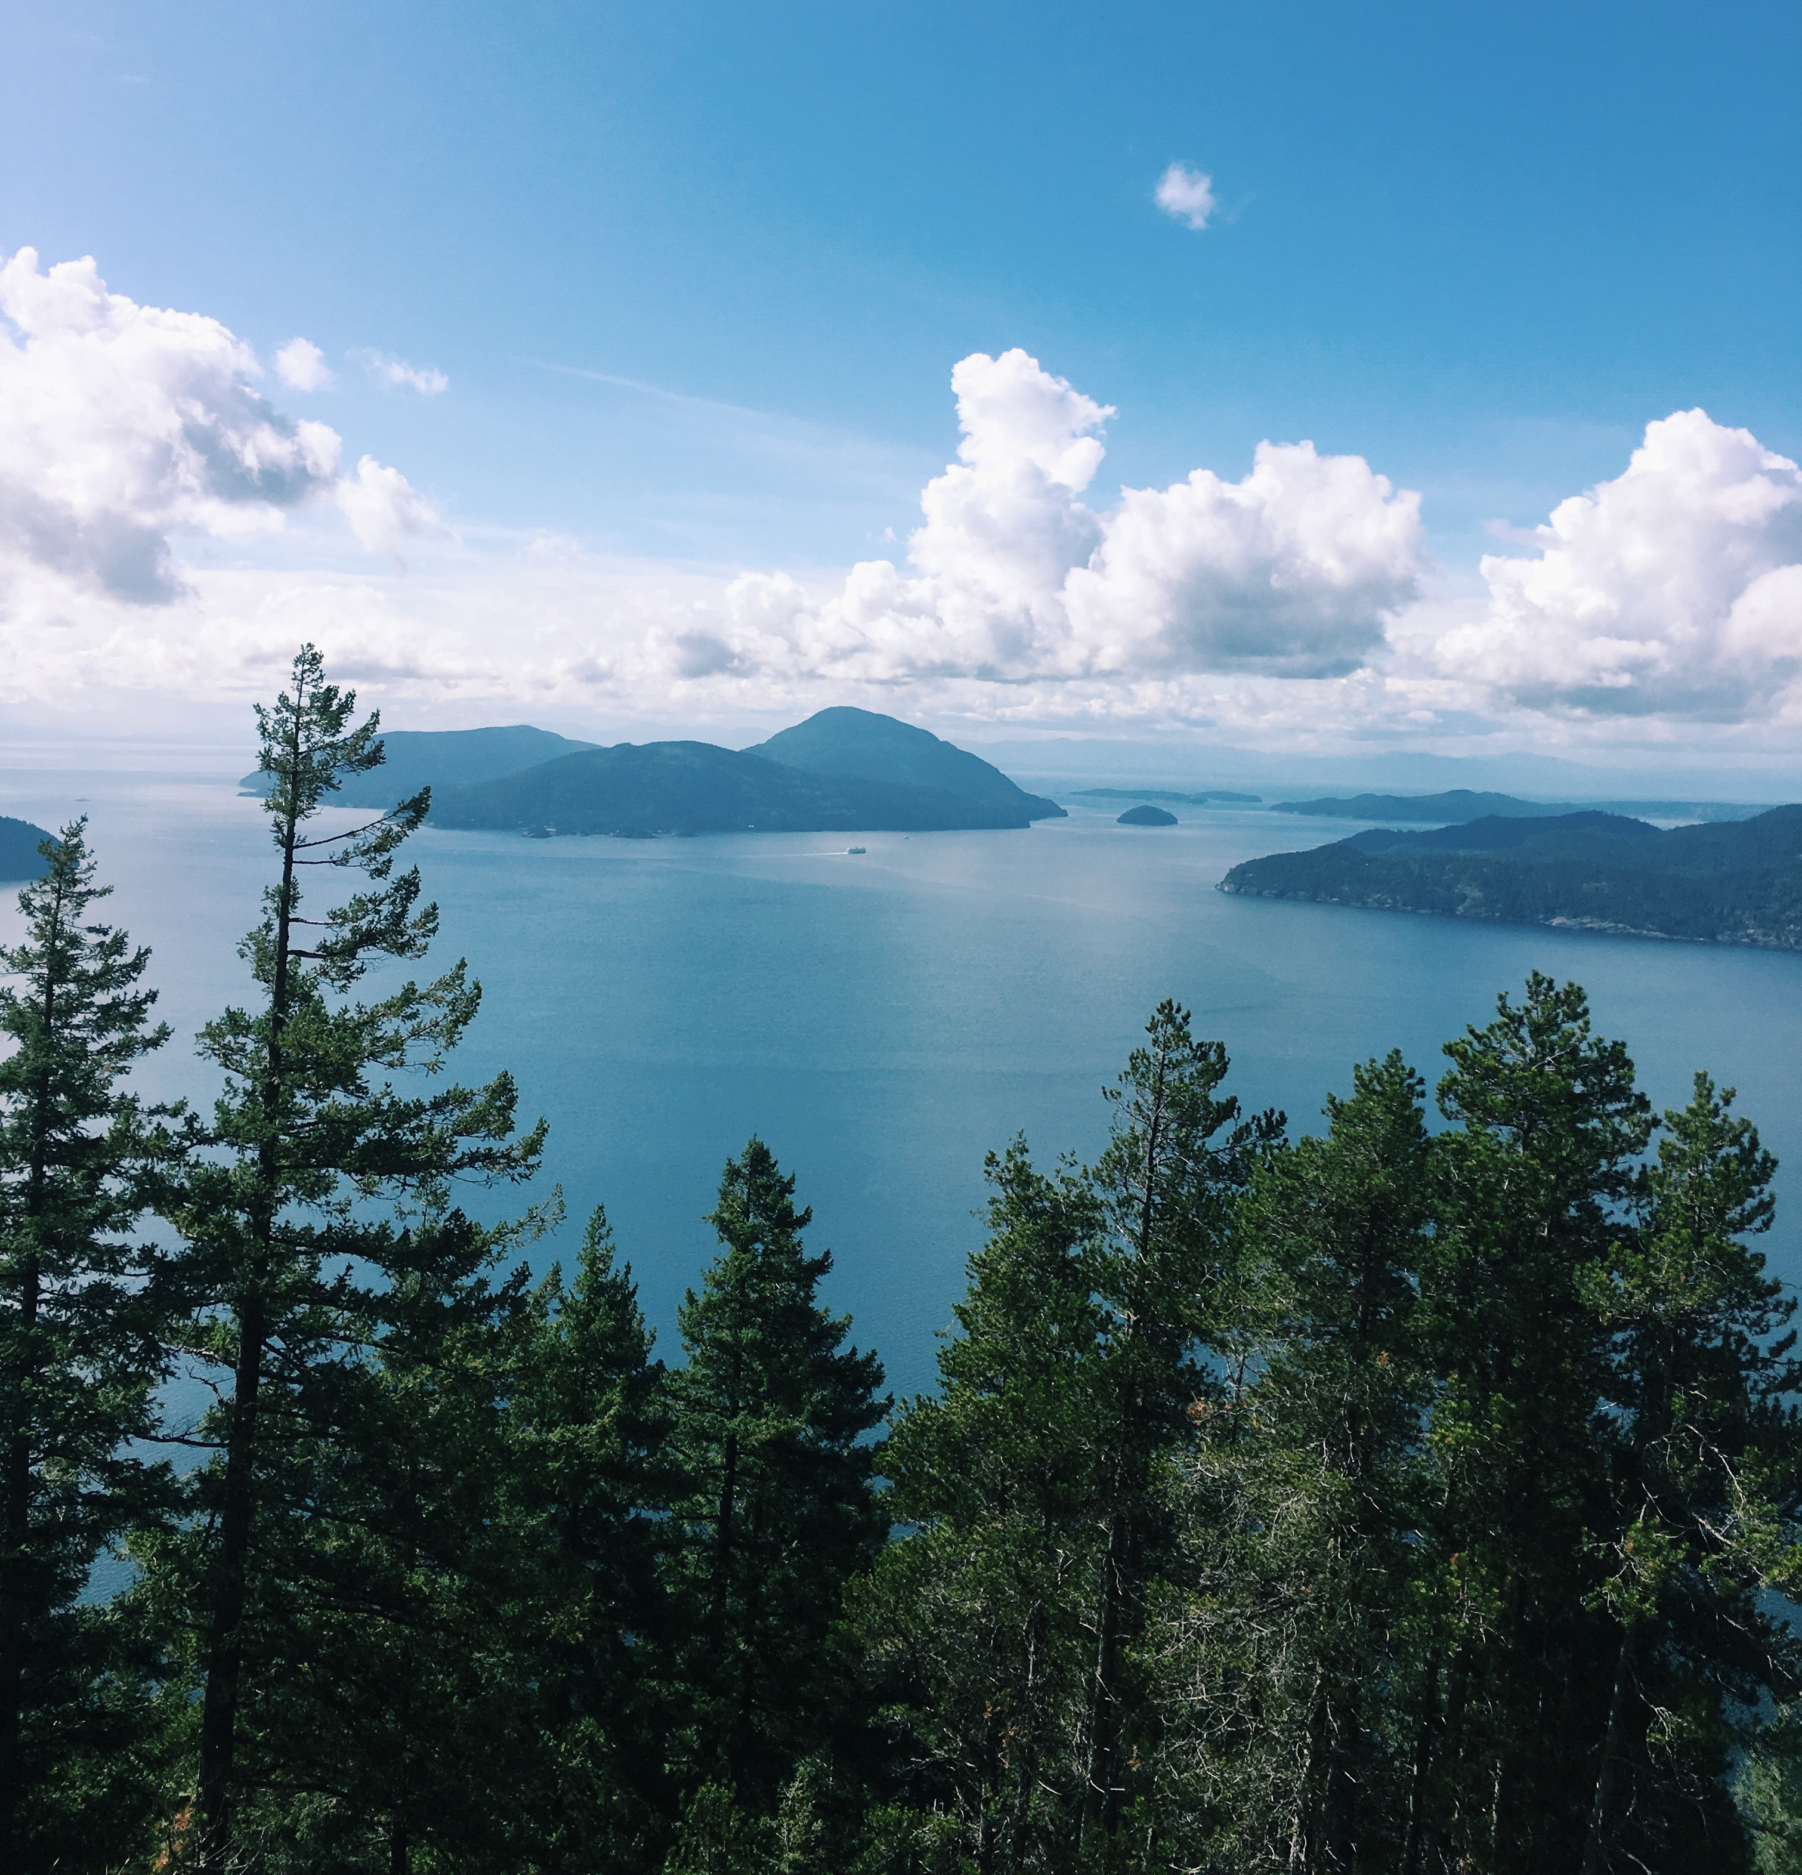
Examples of Activities
A few of my personal favourite activities that I have experienced and believe to be significant to benefitting an individuals mental and physical health are:
Hiking/Exploring New Trails
Kayaking
Snowboarding
Camping
….and many more I have yet to experience!

Slide 5
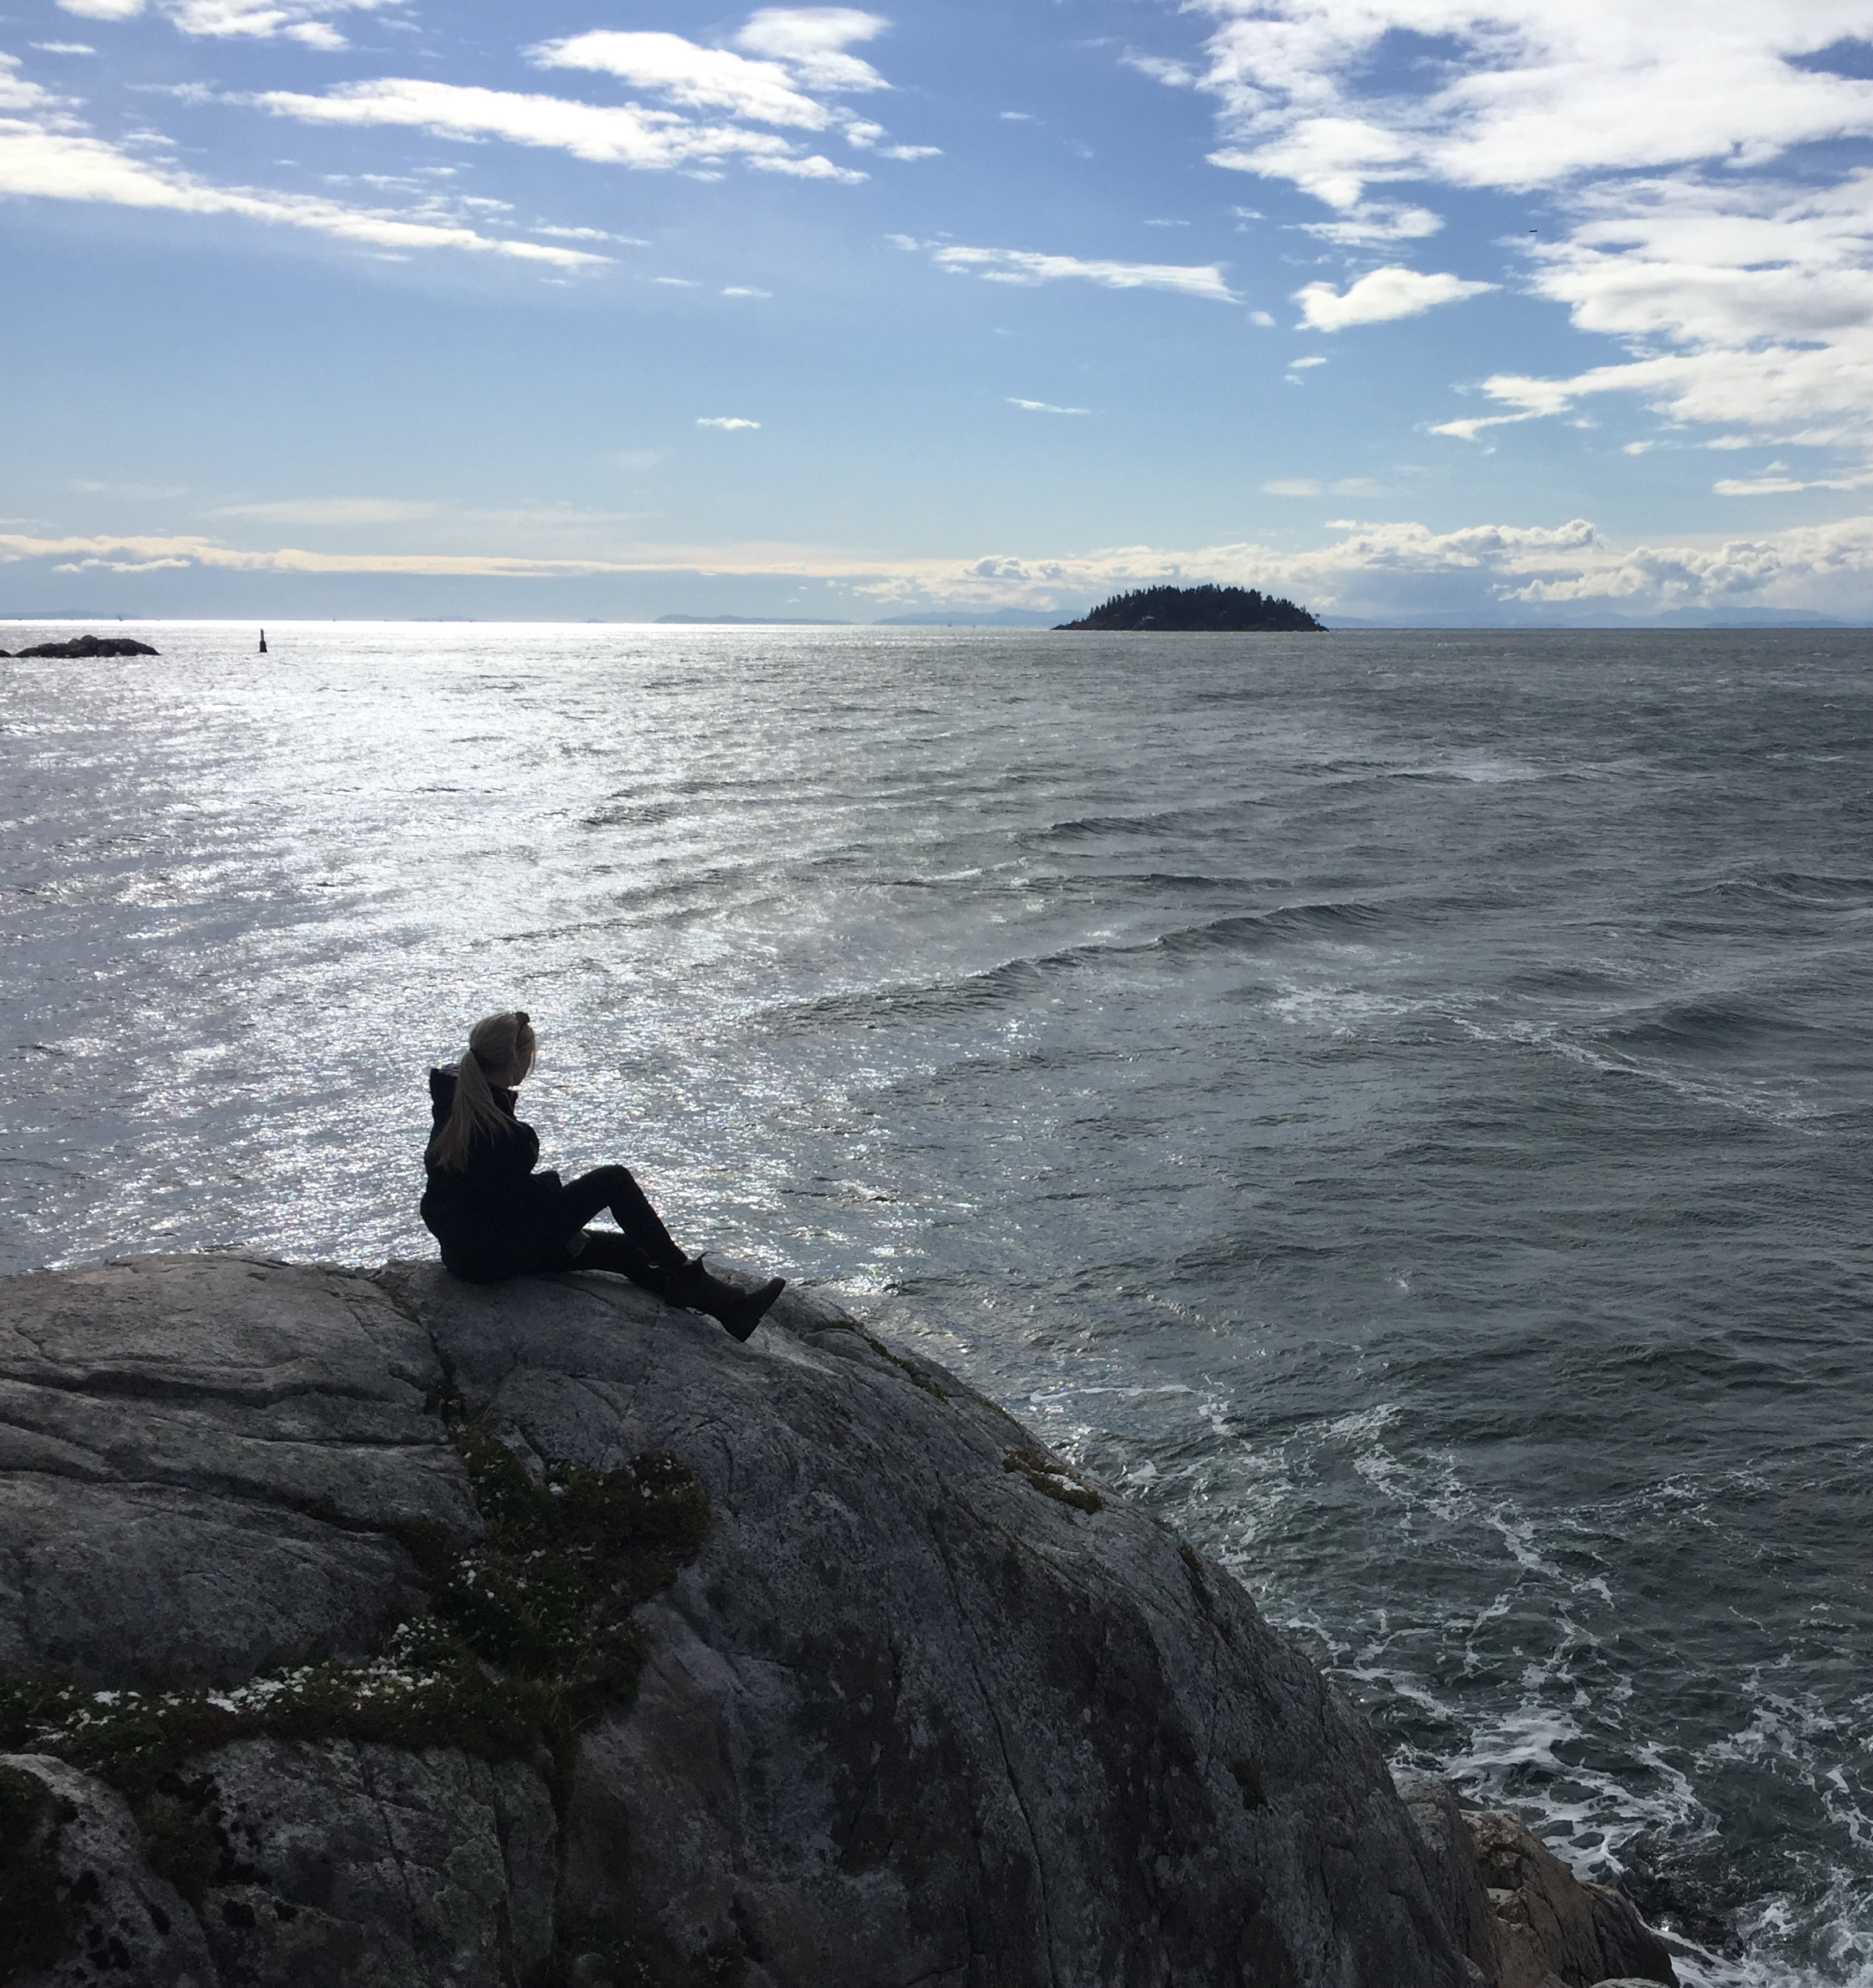
1) Hiking and Exploring Trails
Hiking and adventuring out on new trails or familiar trails are both a great mode of exercise for an individual’s physical health
Hiking and adventuring also enables individuals to breathe in fresh air, boost any mood, reduce stress or tension and calm any anxiety by giving the individual something to look forward to
Hiking is a simple way to get exercise by following a designated path that often leads to a beautiful view, despite the difficulties of scaling the side of a mountain, the view at the top is worth it

Slide 6
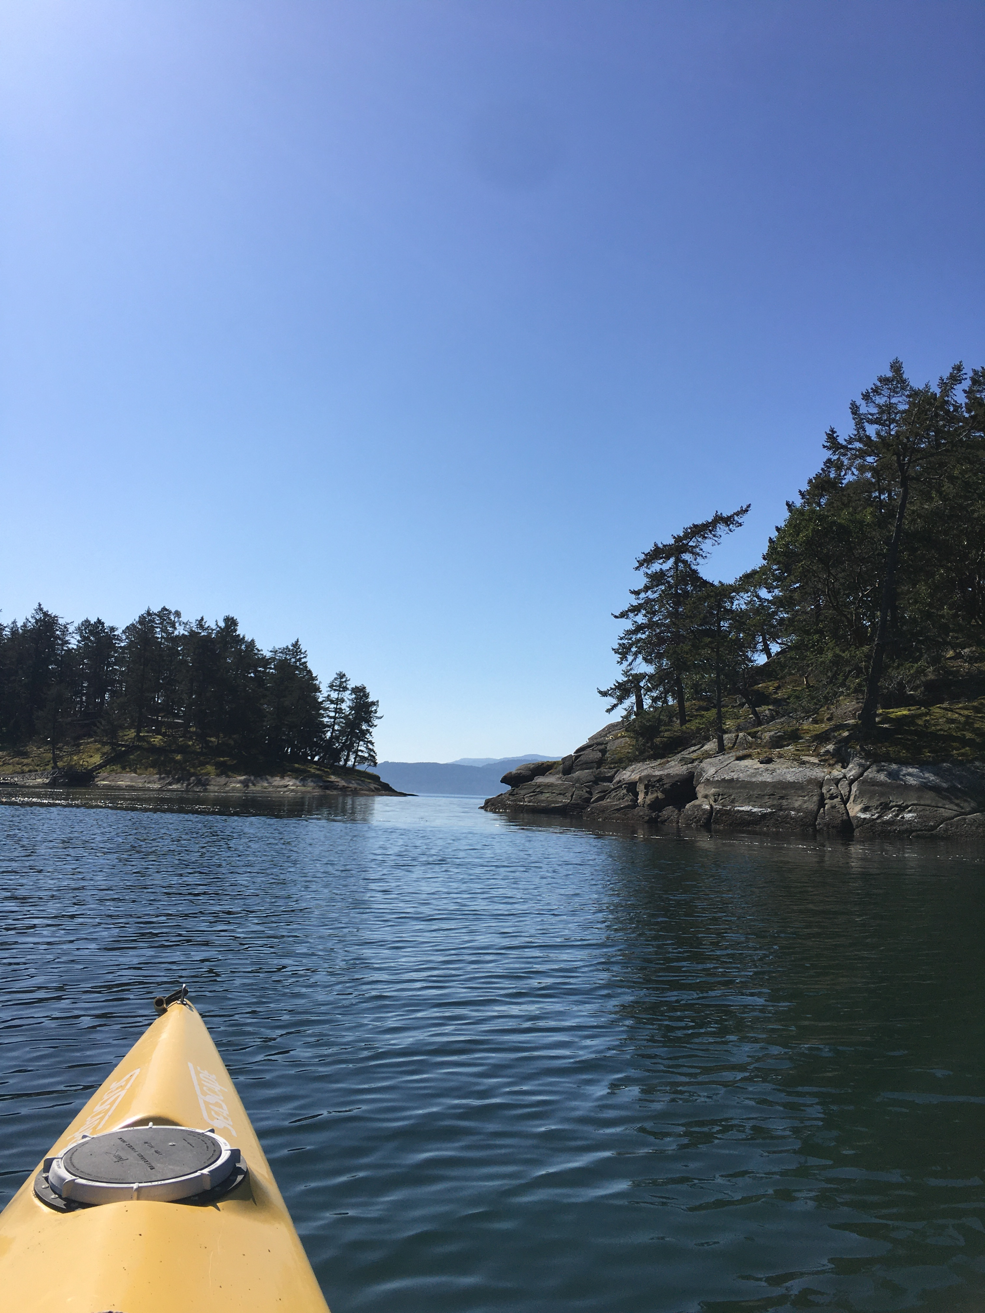
2) Kayaking
A personal favourite outdoor activity of mine is kayaking because it allows an outdoor adventure opposite to hiking up a dirt path on a mountain or trail
In contrast to the physical demands of hiking up a mountain and using your leg muscles, kayaking allows a workout for your arms, core and shoulders
Kayaking allows an adventure on the water, changing the view of a hike from mountains to seeing the peacefulness of water, sea creatures (if you’re lucky), and provides a different perspective to a beautiful view than being on land would
Canoeing also provides similar benefits!
https://people.com/style/bernie-sanders-viral-meme-crewneck-charity-sells-out-after-day/

Slide 7
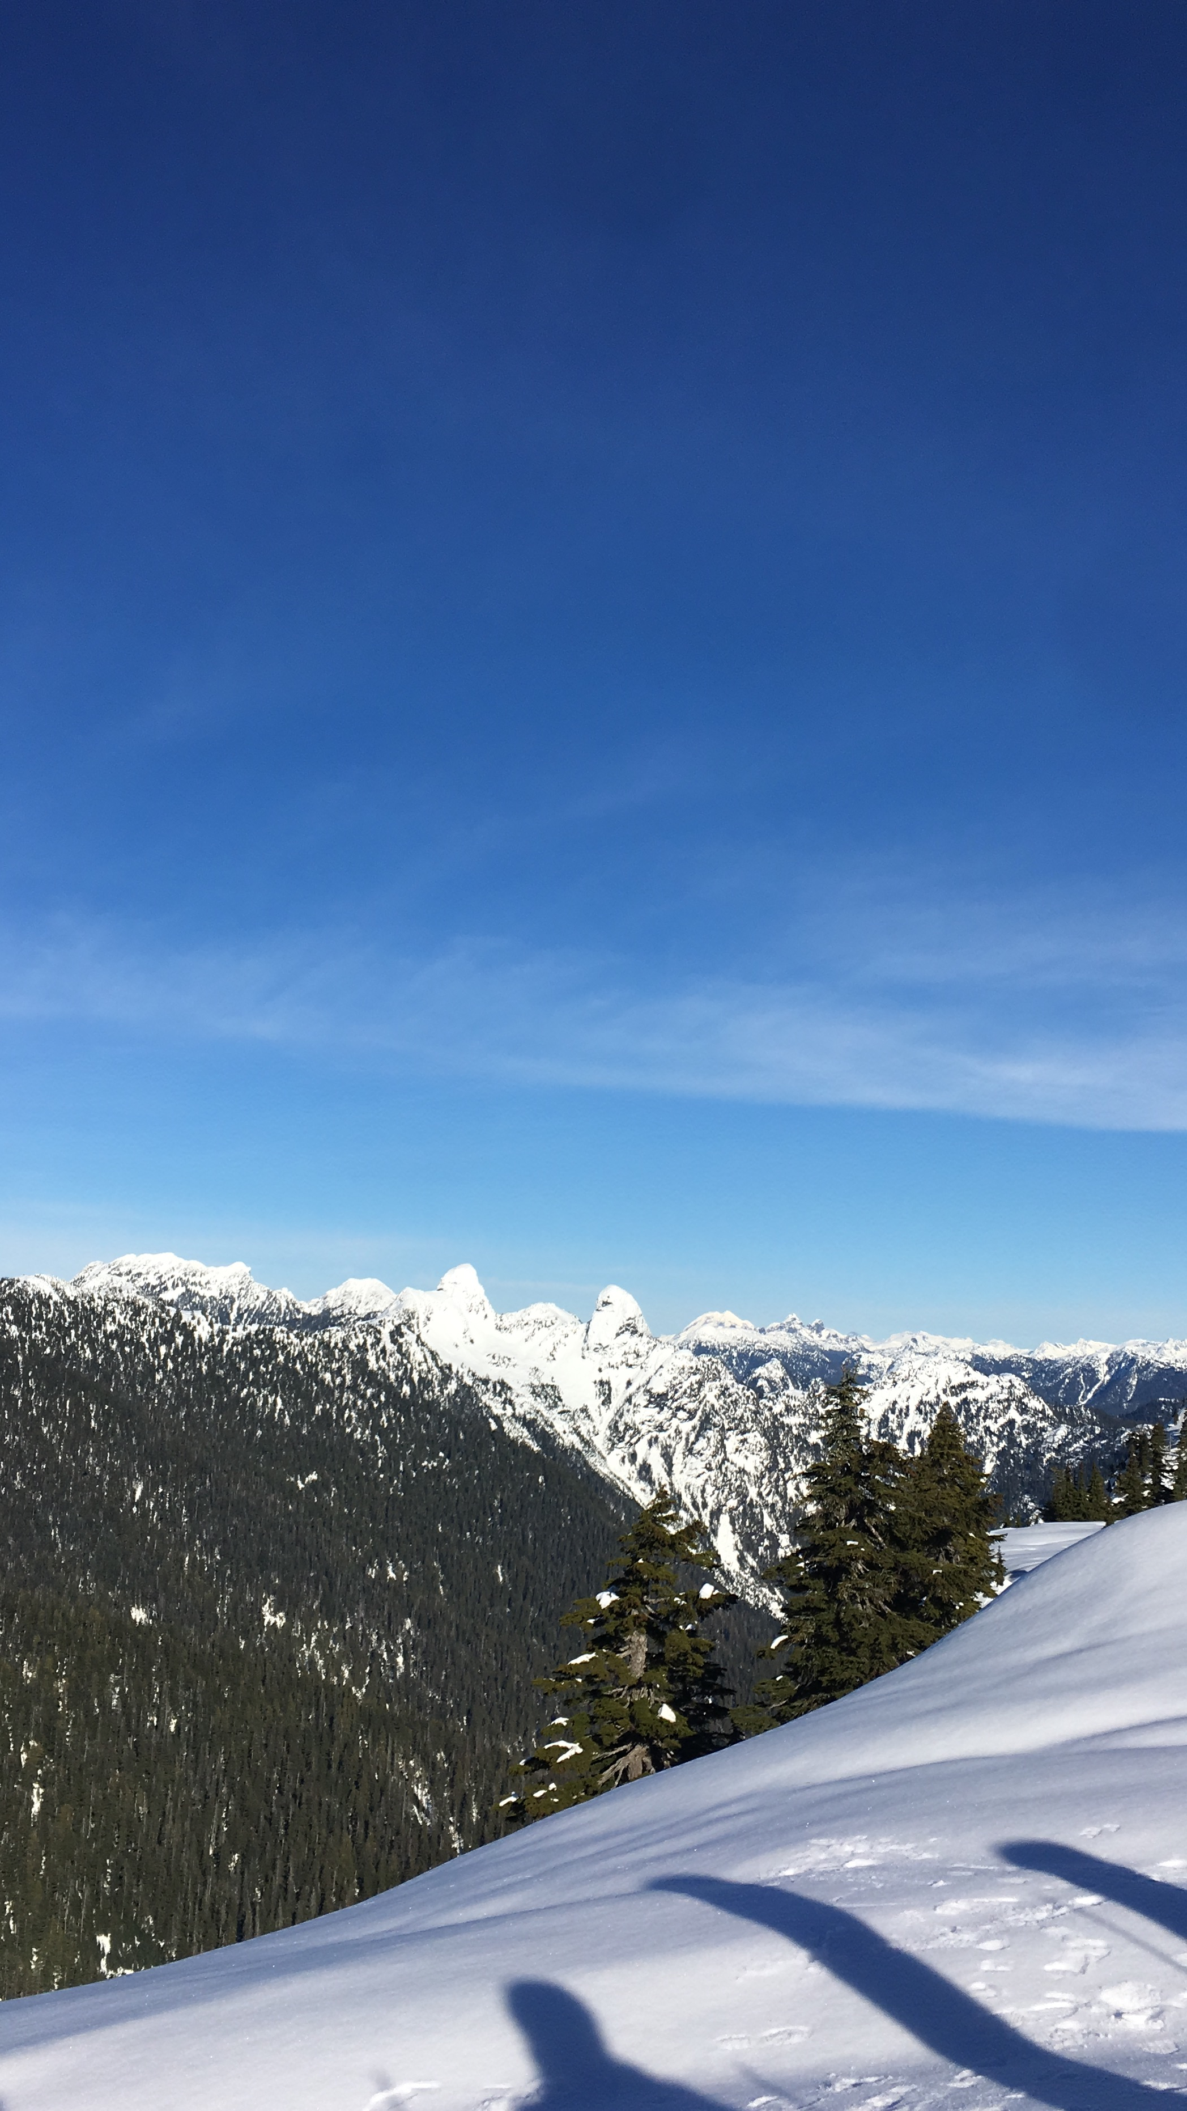
3) Snowboarding
In addition to hiking and kayaking, snowboarding also provides a different perspective and experience in relation to exploring nature
Snowboarding allows individuals to be able to explore the mountains in the middle of winter when some hikes may be closed, or it is too cold to kayak
Snowboarding provides a diverse experience by being able to compete in an activity, challenges you to improve and have an enjoyable time in snow

Slide 8
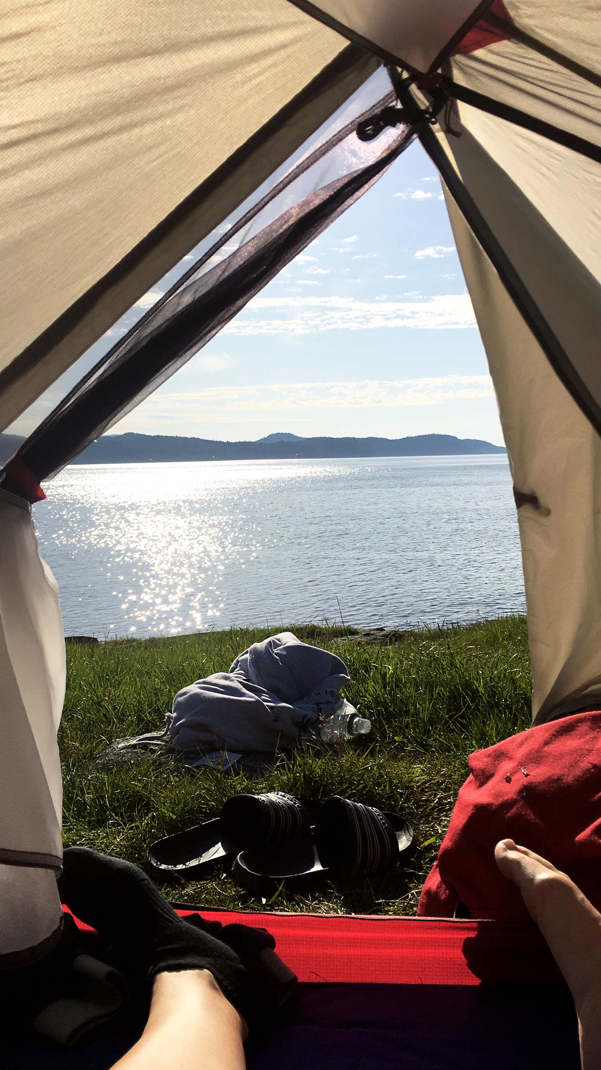
4) Camping
Camping allows a chance to spend an extended period in nature and discover what is like to spend the night outside the comfort of your own home
While camping, you can fall asleep under the stars while listening to the beautiful sounds of nature
During camping, you are also able to engage in various activities such as roasting marshmallows over a campfire or exploring nearby hikes and trails
Camping can provide a boost to mental health by escaping the city or your hometown by engaging in a different atmosphere and away from the busyness of your personal life

Slide 9
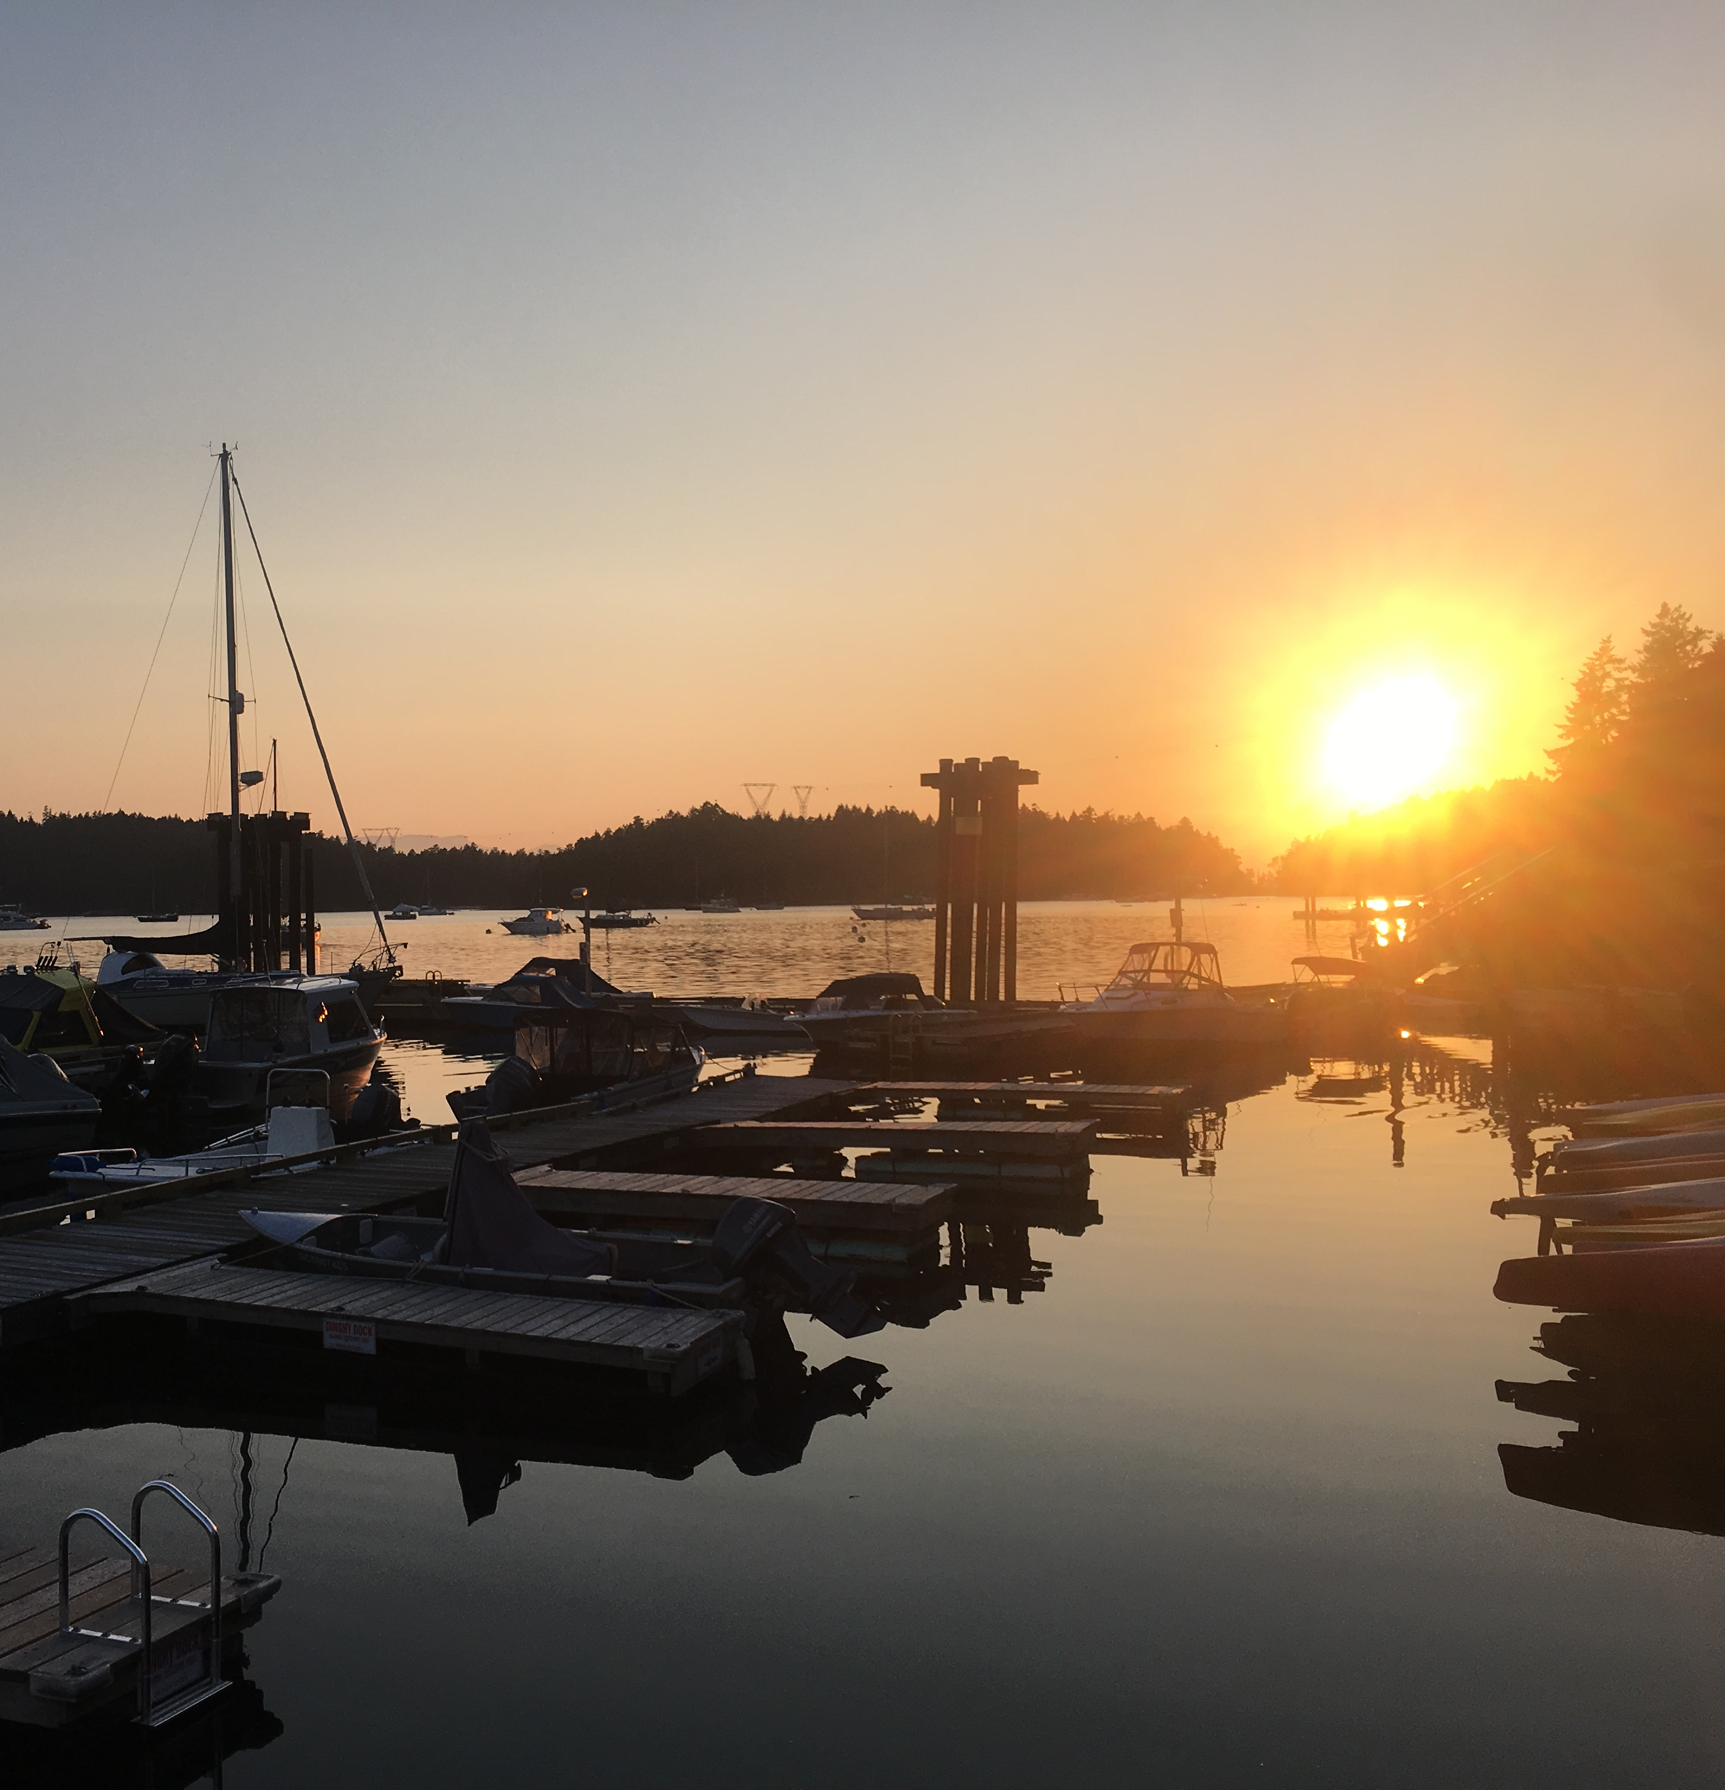
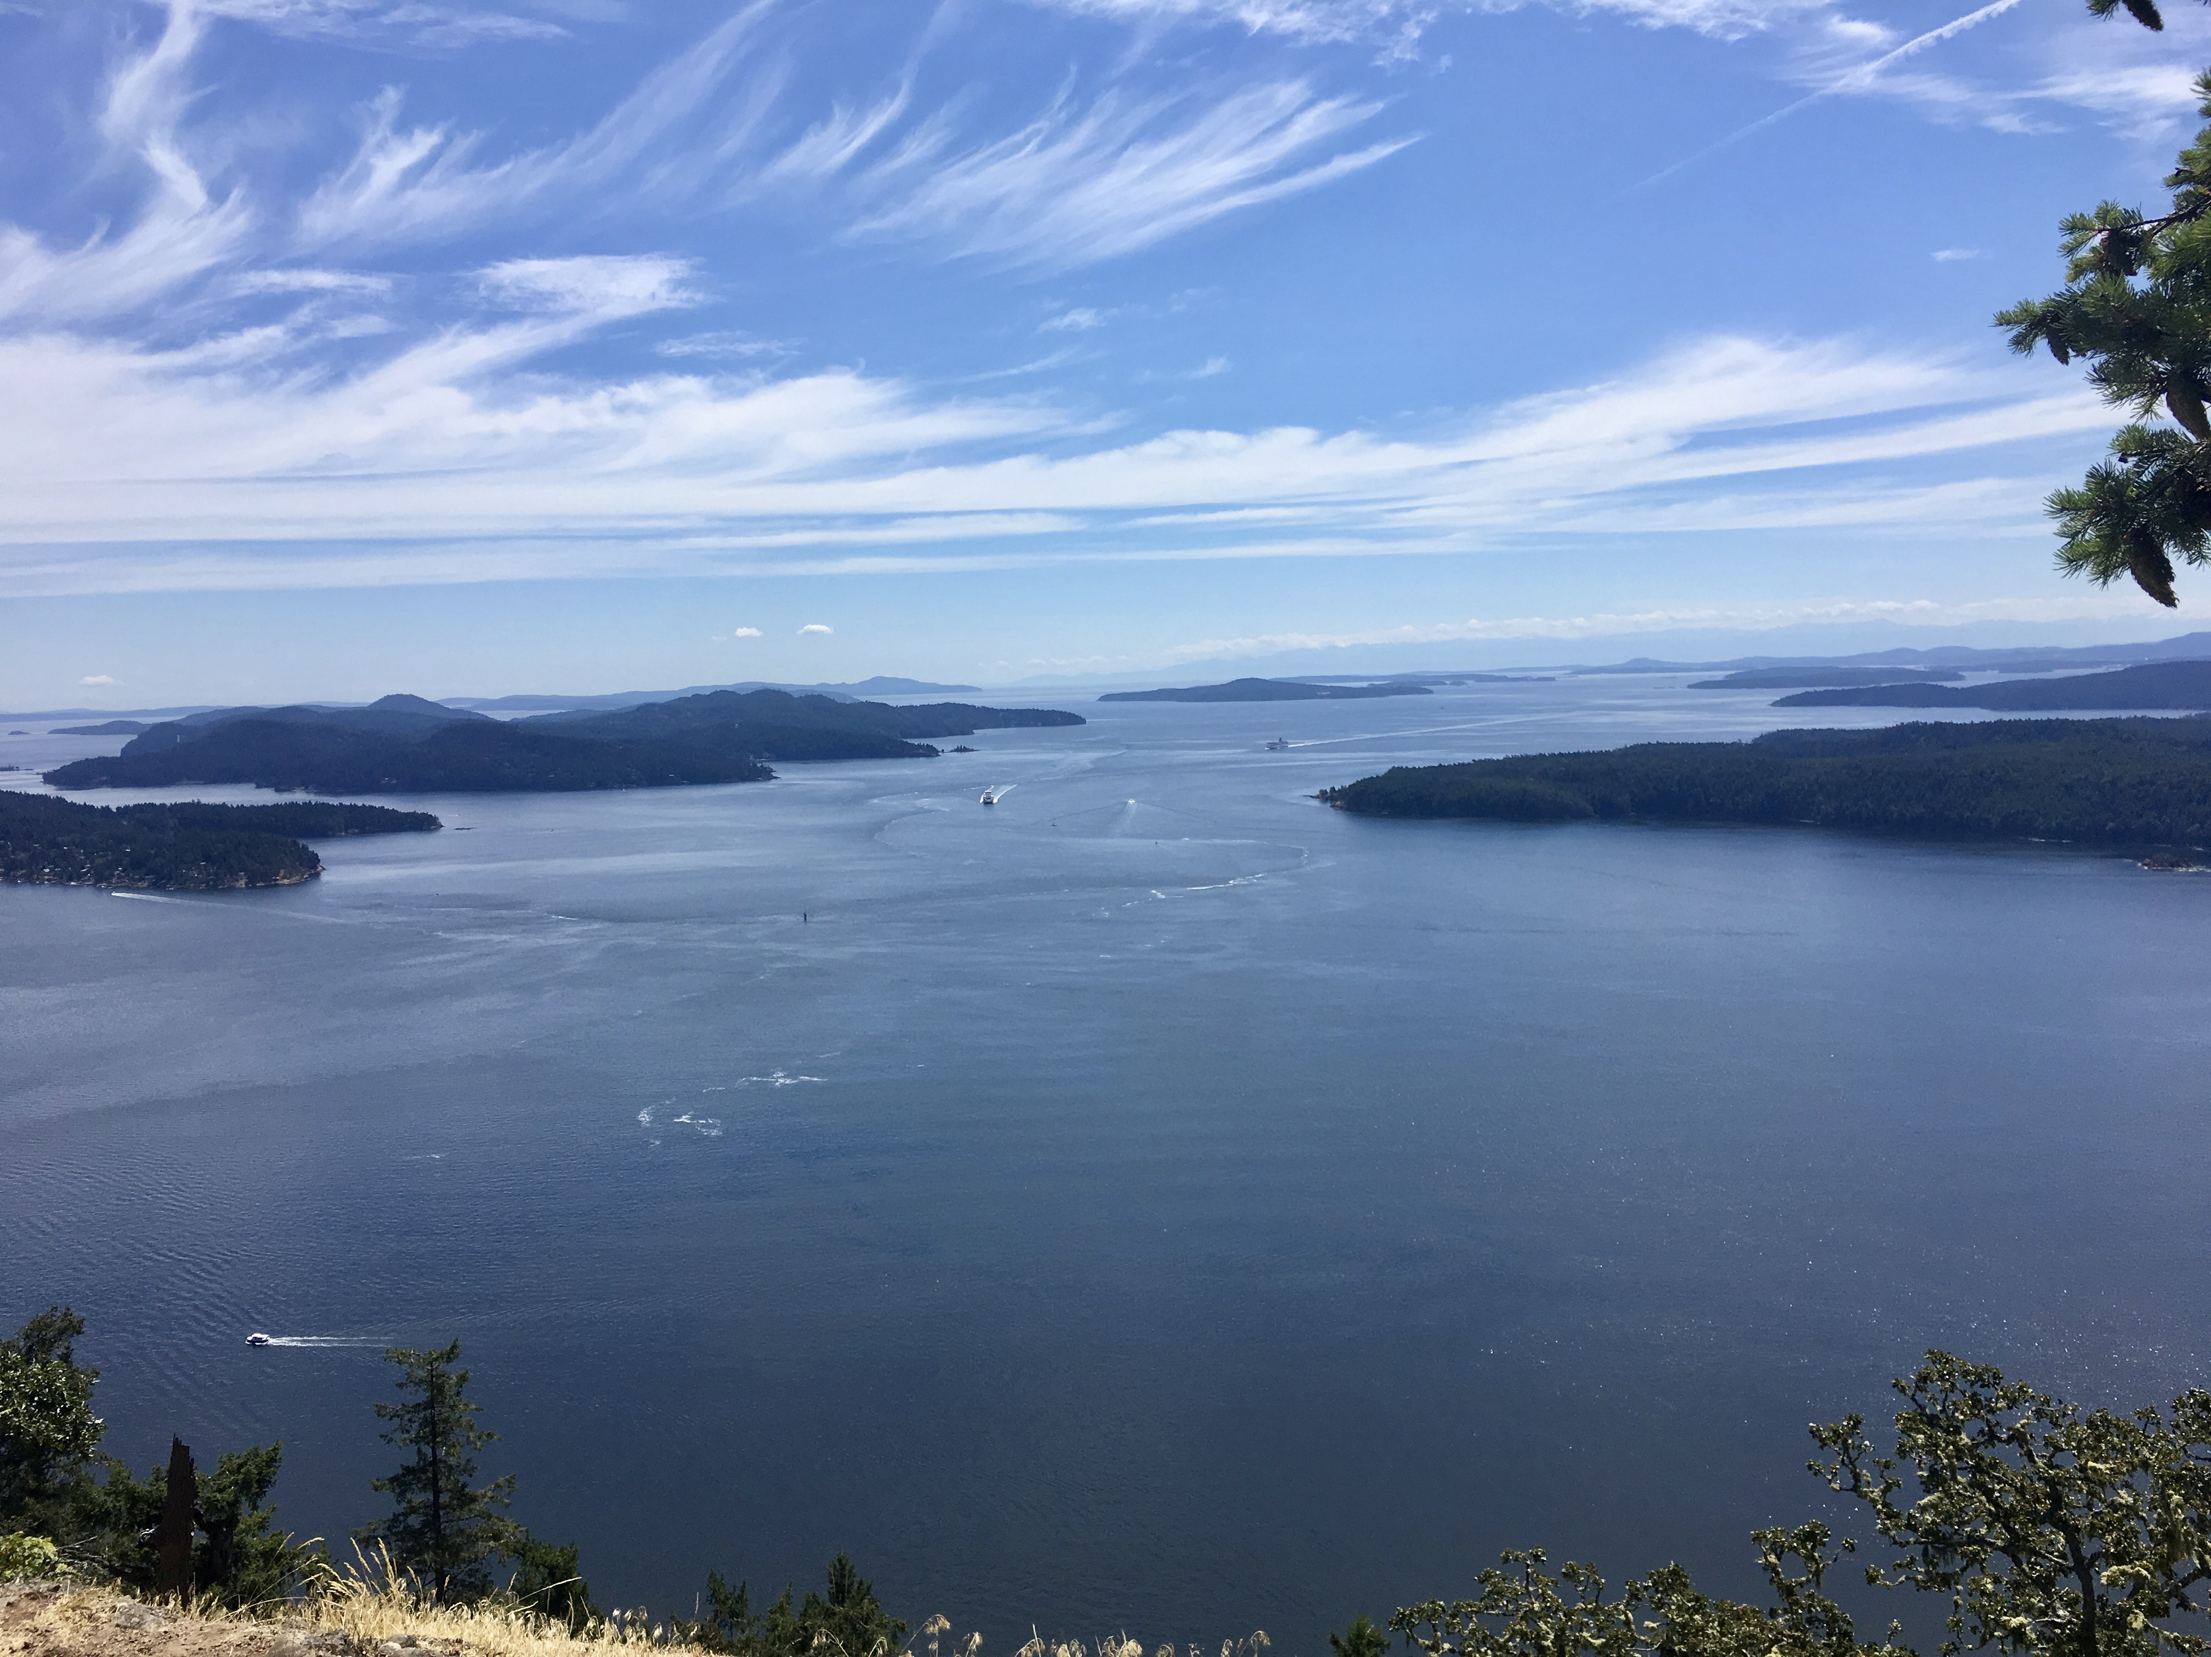
…and many more!
In addition to my personal favourite activities, are there many more various activities that allow can individuals to explore and engage with the outdoors that I will continue to research for my inquiry
Some additional activities that I will research are:
-Biking/Skateboarding
-Boat activities (wakeboarding, tubing or waterskiing)
..and hopefully more!

Slide 10
Additional Thoughts and References:
All photographs attached within this PowerPoint are taken by me, from my iPhone
I will continue to look at new outdoor activities and there significance on an individuals physical and mental health, and will proceed to research and provide links and articles that support my inquires
Bernie Sanders Photo retrieved from https://people.com/style/bernie-sanders-viral-meme-crewneck-charity-sells-out-after-day/

